Slide 1
THE NATION AND THE WORLD ECONOMY

Slide 2
Exchange between parties can be mutually beneficial but conflicts arise over how these gains are distributed.
When goods/services, people, and financial assets can cross national boundaries, new factors are involved.
How can governments influence trade?
What affects the distribution of gains from trade?
When can globalization be detrimental to growth?
(Units 5-9)

Slide 3
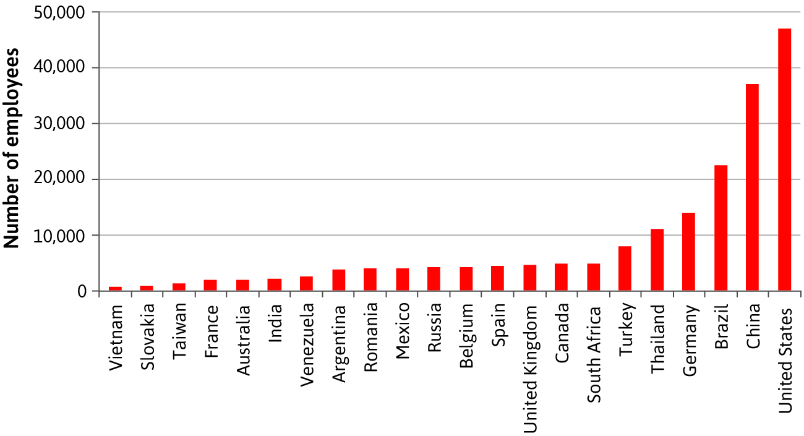
Globalization: A process by which the economies of the world become more integrated by the freer flow across national boundaries of goods, investment, finance, and labour.
Offshoring is an important aspect of globalization.

Slide 4
Use models and concepts from previous units to explain the effects of globalization on:
International markets for goods and services (trade)
International capital markets (flows of savings and investment)
International labour markets (migration)

Slide 5
B. Measuring Globalization

Slide 6
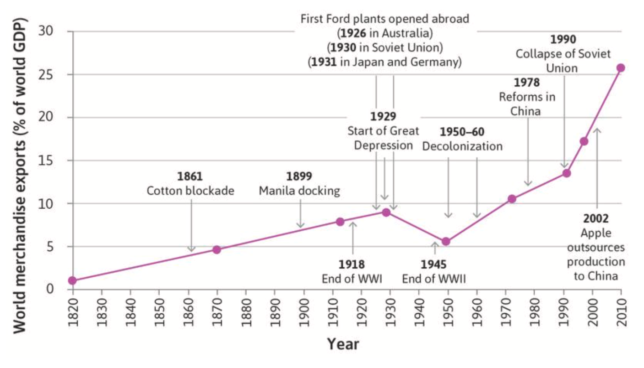
Integration of Goods Markets
Merchandise trade: Tangible products that are physically shipped across borders.
Common measures of globalization:
1. Imports/exports/total trade as a share of GDP
Clear upward trend in amount of trade worldwide (except from 1914-1945), with sharp acceleration from 1990s onwards.

Slide 7
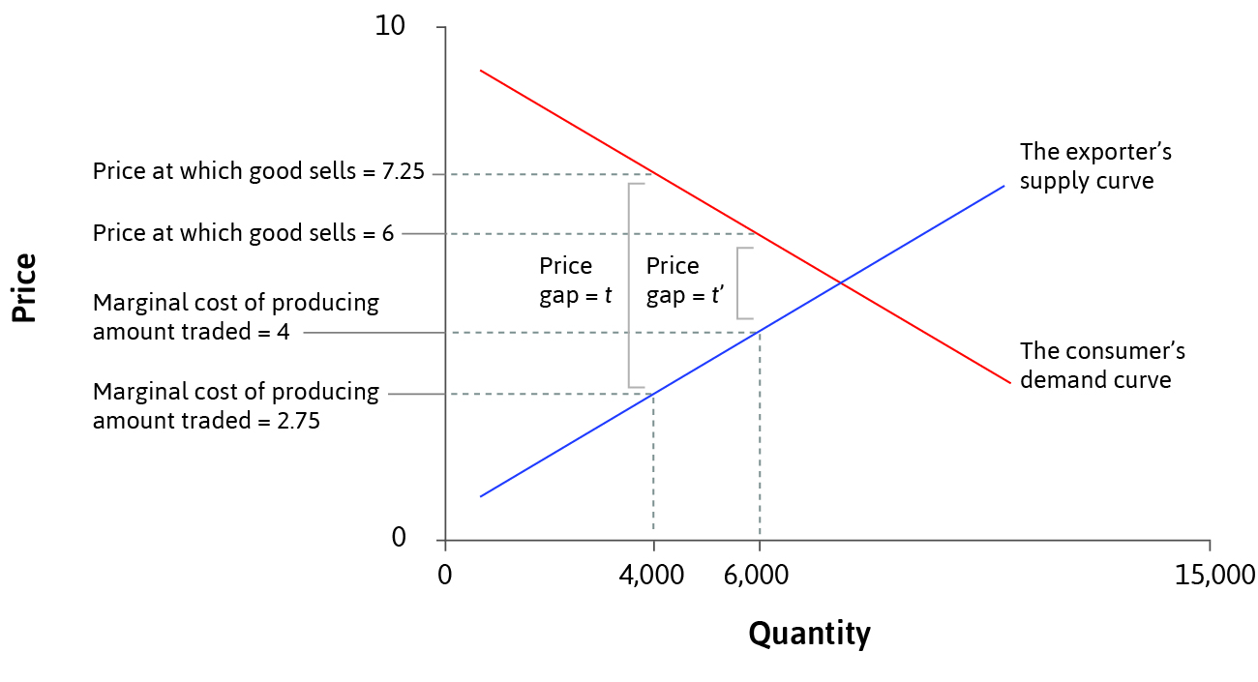
Integration of Goods Markets
2. Reduction in trade costs (price gaps) between countries
Law of One Price should hold if there are no transport costs or barriers to trade.
Price gap: Difference in the price of a good in the exporting and importing country.
Due to arbitrage, in competitive equilibrium the price gap should equal the sum of all trade costs.

Slide 8
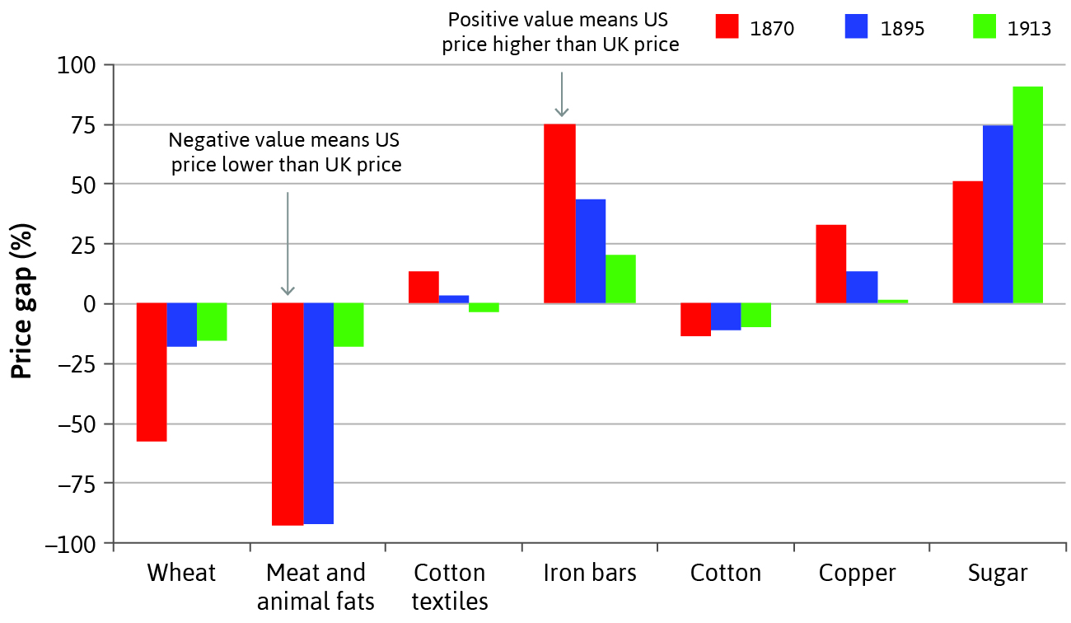
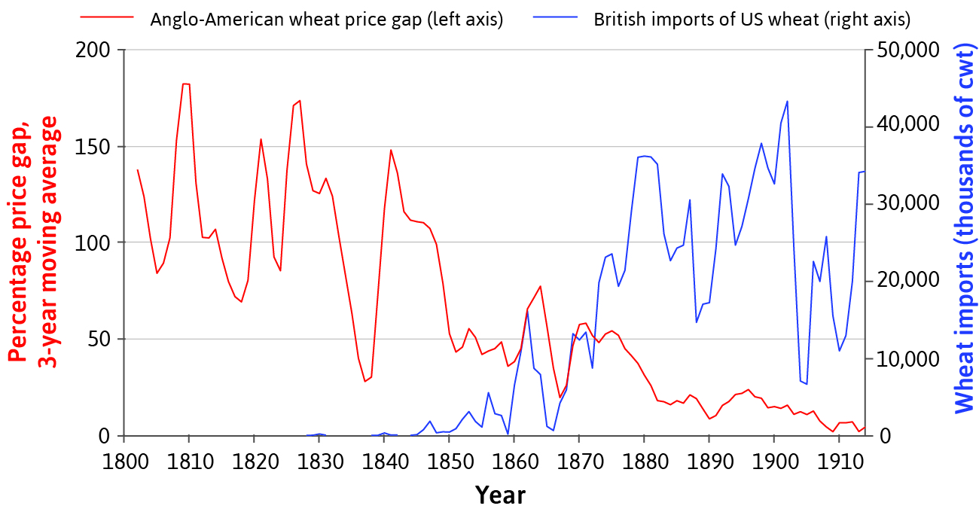
Evidence of globalization of goods
Price gaps between countries have generally declined over time, while the volume of goods traded has generally increased.

Slide 9
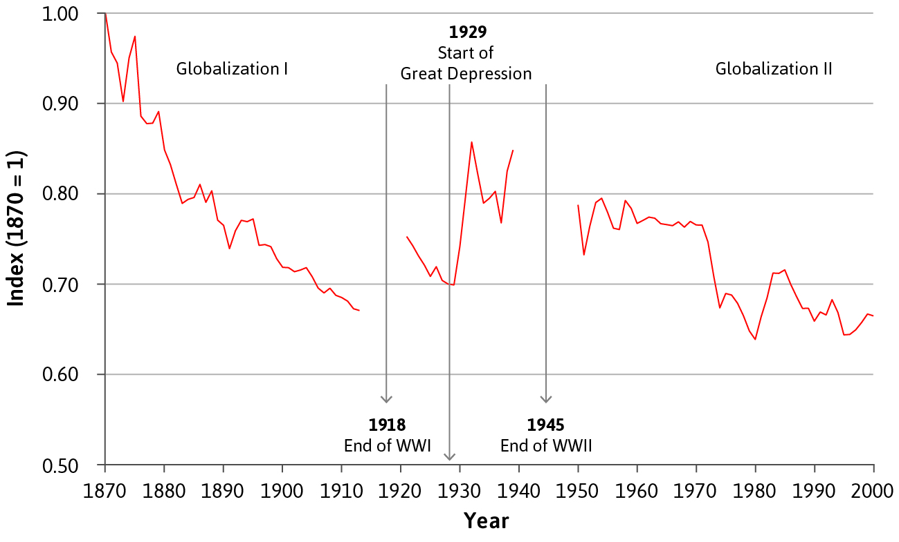
Trends in globalization of goods
Two separate periods of increasing global economic integration:
Globalization I: before 1870 until 1914
Globalization II: the end of the Second World War until now
Deglobalization: increasing trade costs during the Depression.
Partly due to protectionist policies aimed at protecting domestic employment (tariffs and quotas on imports).

Slide 10
Integration of Capital Markets
Countries lend and borrow from each other to finance investment.
The balance of payments records the sources and uses of foreign exchange, which include:
Portfolio investment: buying foreign stocks/bonds
Foreign direct investment: ownership of foreign physical assets
Current account (CA) = exports – imports + net investment
CA deficit: Country is borrowing (receiving net capital flows)
CA surplus: Country is lending (net capital outflow)

Slide 11
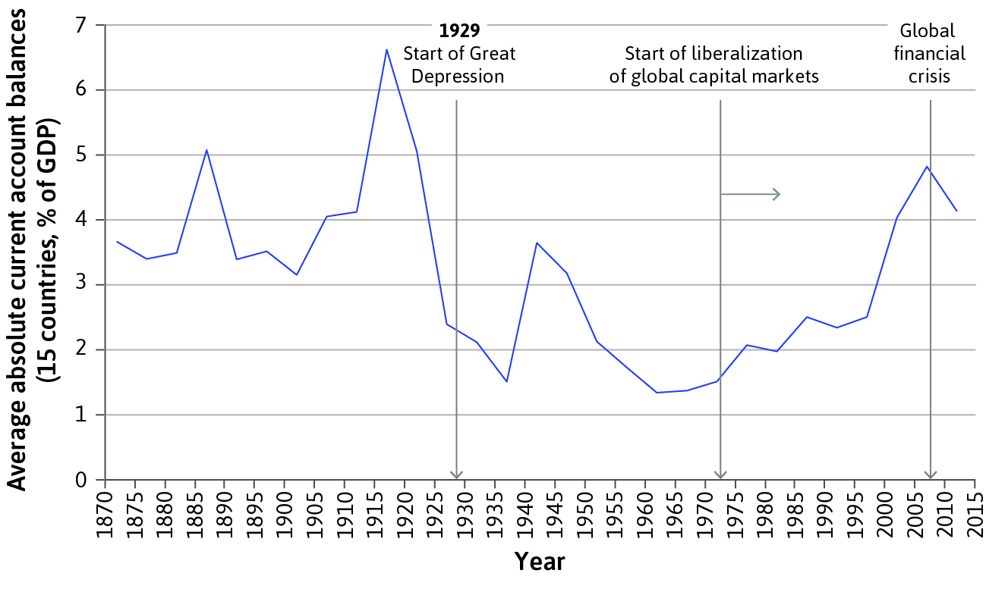
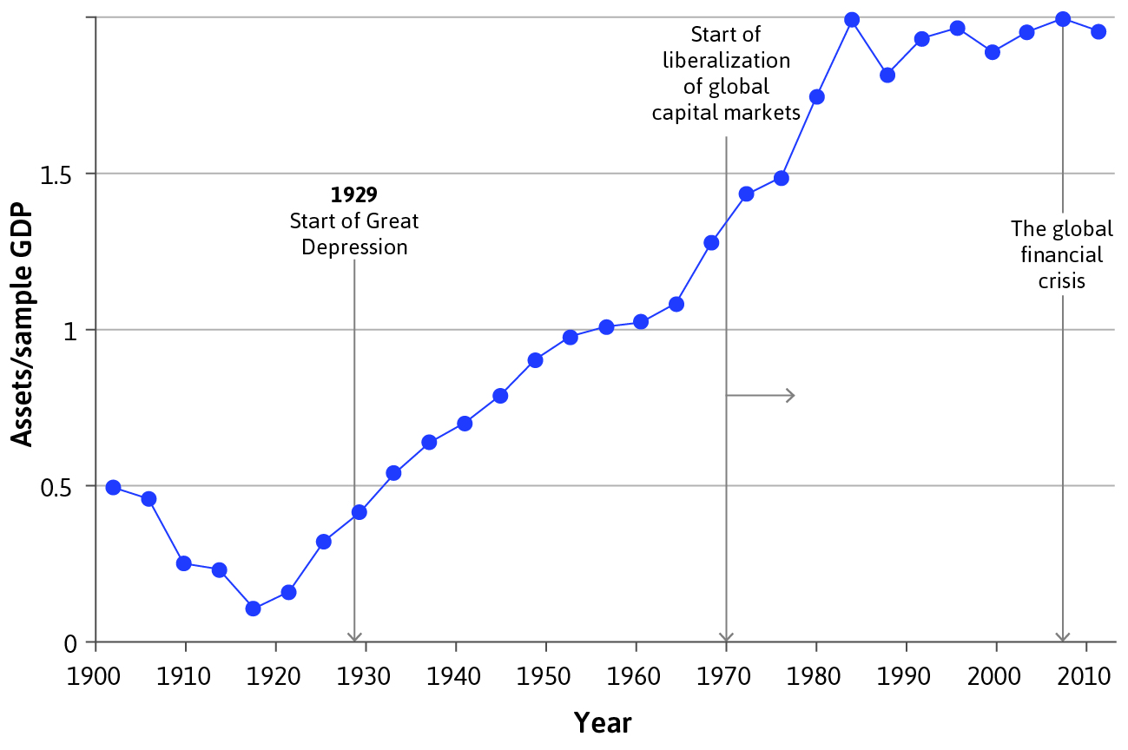
Trends in globalization of capital markets
Historically, increased trade resulted in larger CA imbalances. (Countries that trade more also tend to borrow and lend more)
International asset holdings increased over the 20th century.

Slide 12
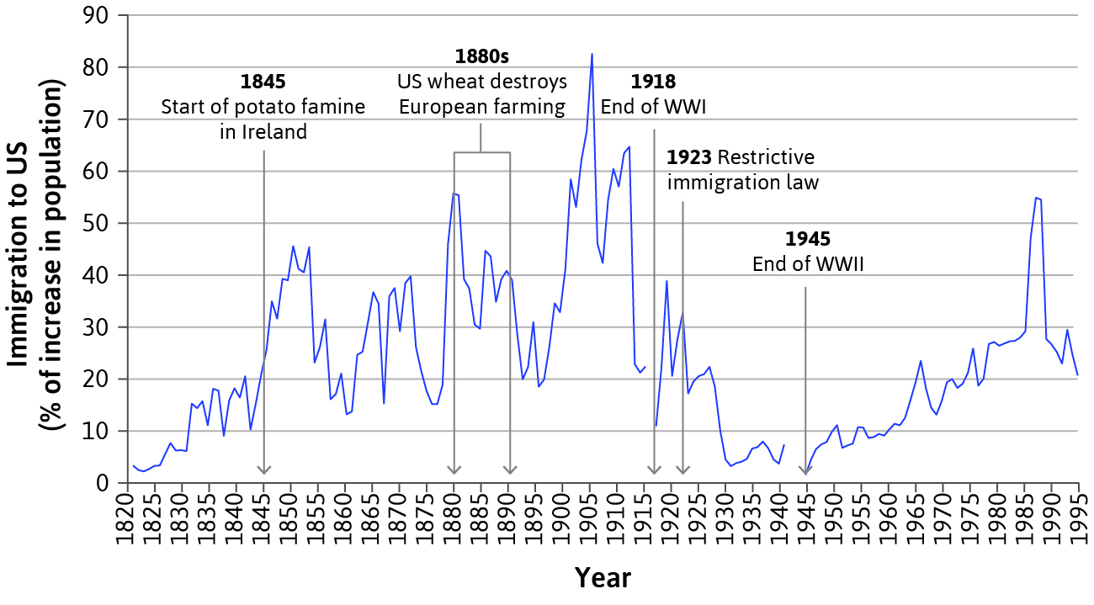
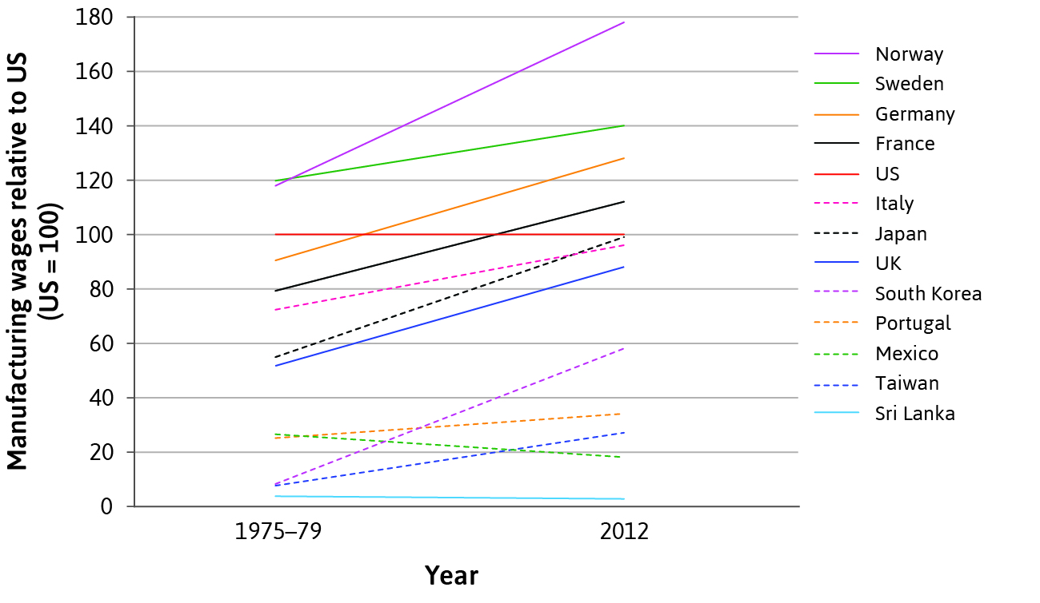
Integration of labour markets?
Fewer advances in labour market integration than goods or financial market integration due to immigration barriers.
Wages still differ across countries due to migration costs.

Slide 13
C. Specialization and Trade

Slide 14
Specialization
Increased globalization means that most nations engage in both specialization and trade.
Specialization: when an entity produces a narrower range of goods than it consumes, acquiring the rest through trade.
Reasons for specialization include:
Comparative advantage in producing particular goods
Economies of agglomeration – cost reductions from locating close to other firms in similar industries
Economies of scale – cost advantages from producing more

Slide 15
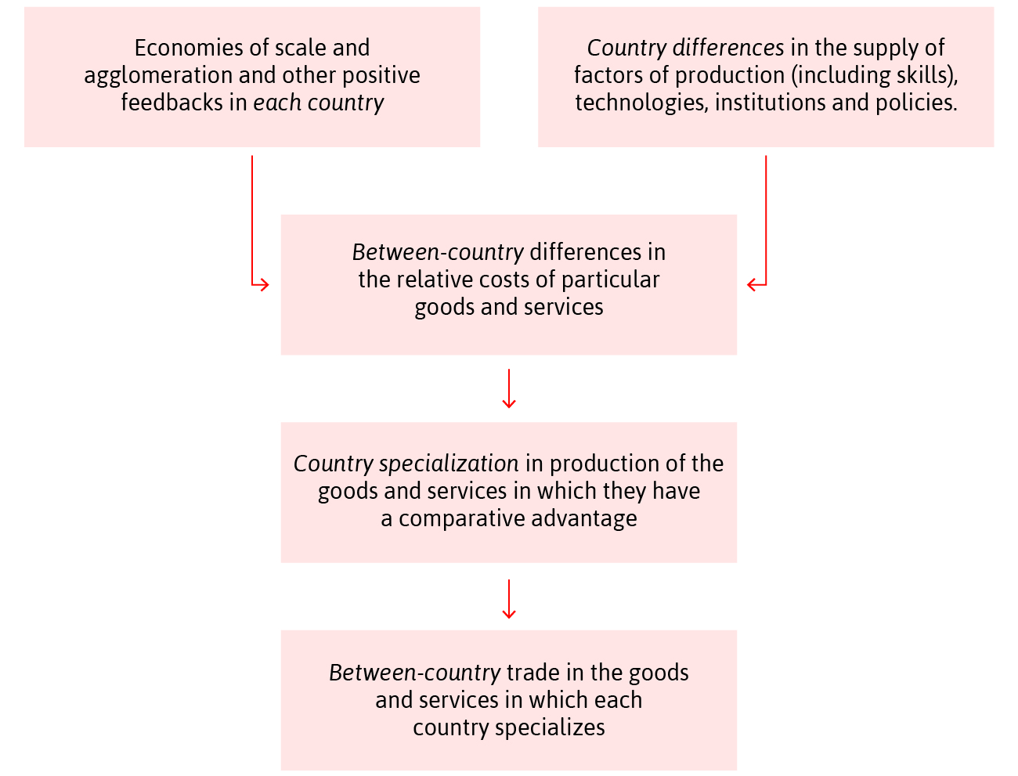
Comparative Advantage
Absolute advantage: uses fewer inputs to produce a good
Comparative advantage: greatest absolute advantage, or least productivity disadvantage (comparatively better)
Trade can be mutually beneficial when both parties specialize in the good in which they have a comparative advantage.

Slide 16
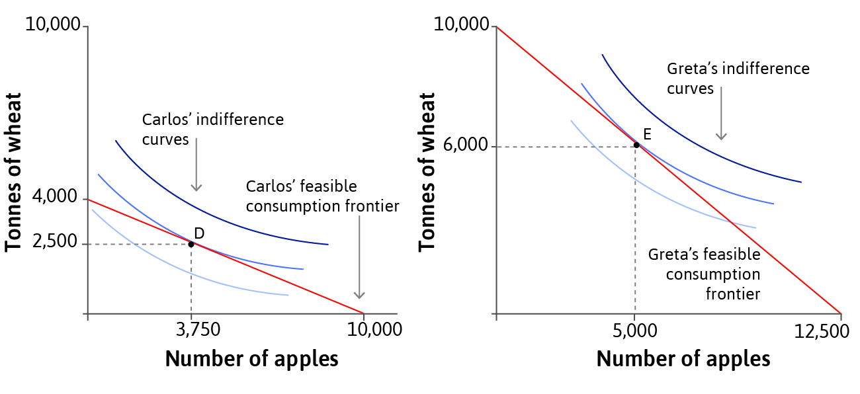
Comparative Advantage: Example
Greta lives on Wheat Island and Carlos lives on Apple Island.
Greta has an absolute advantage in producing apples and wheat.
Carlos has a comparative advantage in producing apples.
In the absence of trade, the feasible consumption frontier = feasible production frontier (they can only consume what they produce).

Slide 17
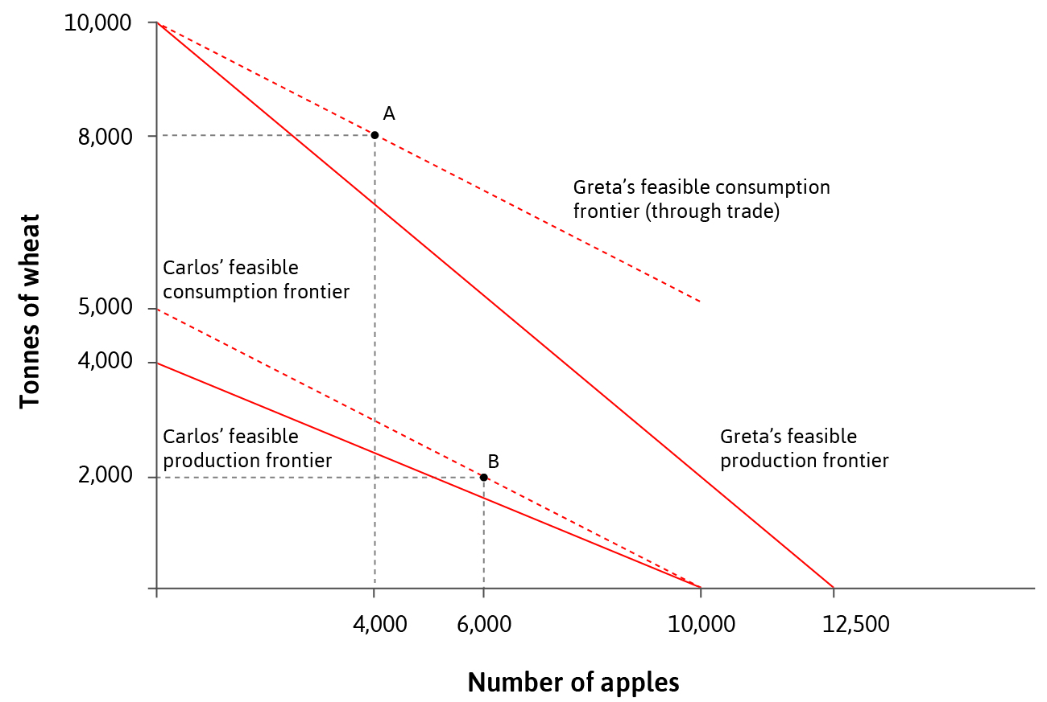
Comparative Advantage: Example
With trade, Carlos specializes in producing apples and Greta specializes in producing wheat.
Both of their consumption frontiers are above their production frontiers, so they are both better off.
The relative price of apples to wheat depends on each person’s bargaining power and reservation option.

Slide 18
Winners and Losers: Short Run
Opening trade increases countries’ consumption possibility sets, but conflicts of interest emerge between and within countries.
Winners and losers from trade depend on the relative scarcity of factors e.g. skilled/unskilled labour, capital:
Relatively abundant factors within a country are relatively cheap, and gain when trade raises their price towards the world average.
Conversely, the price of relatively scarce factors falls towards the world average due to trade.

Slide 19
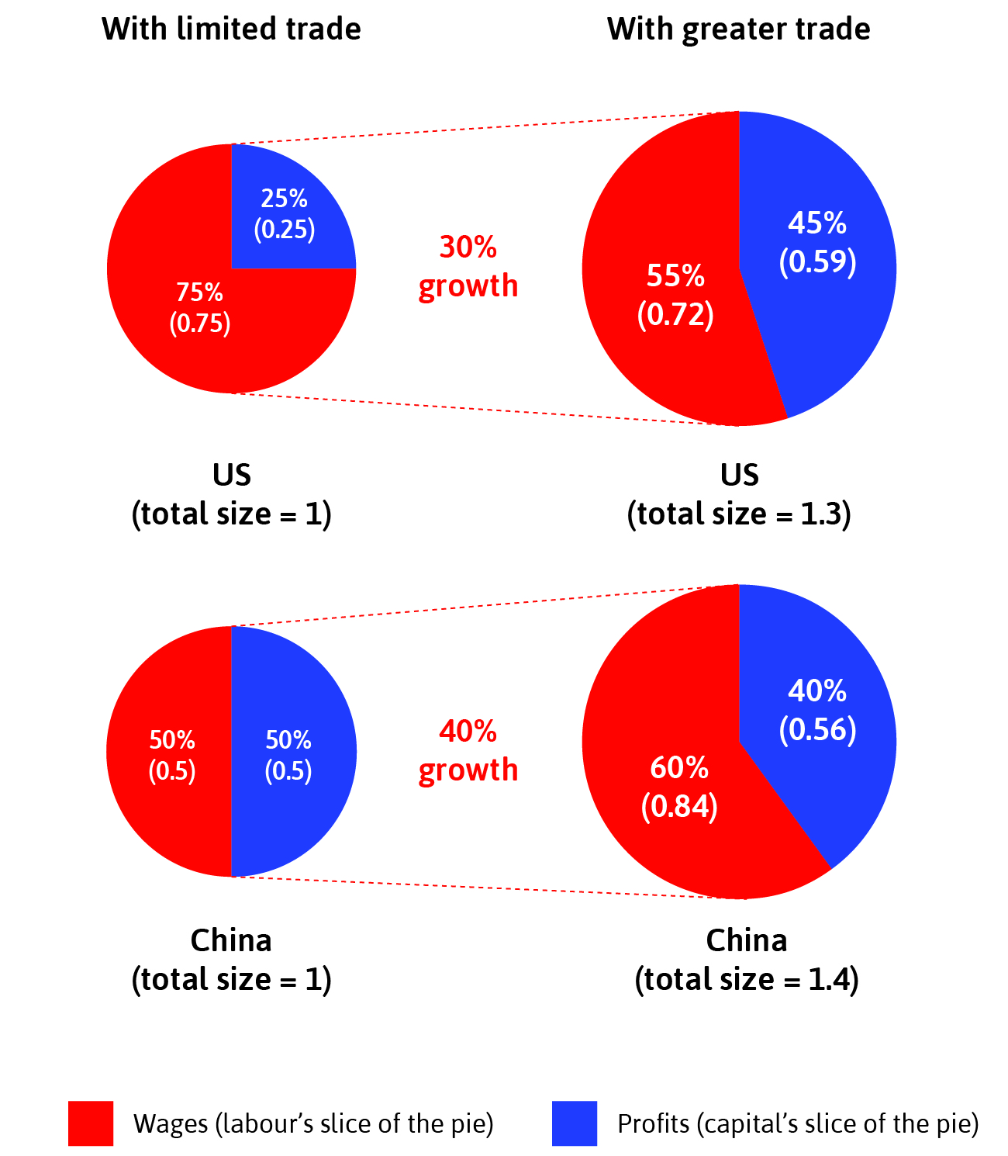
Hypothetical example
There are 2 goods: passenger aircraft (capital-intensive) and consumer electronics (labour-intensive).
The US is relatively capital abundant, whereas China is relatively labour abundant -> specialization according to factor endowments.
Winners in the US: Owners of capital -> inequality should rise
Winners in China: Workers (higher wages) -> inequality should fall

Slide 20
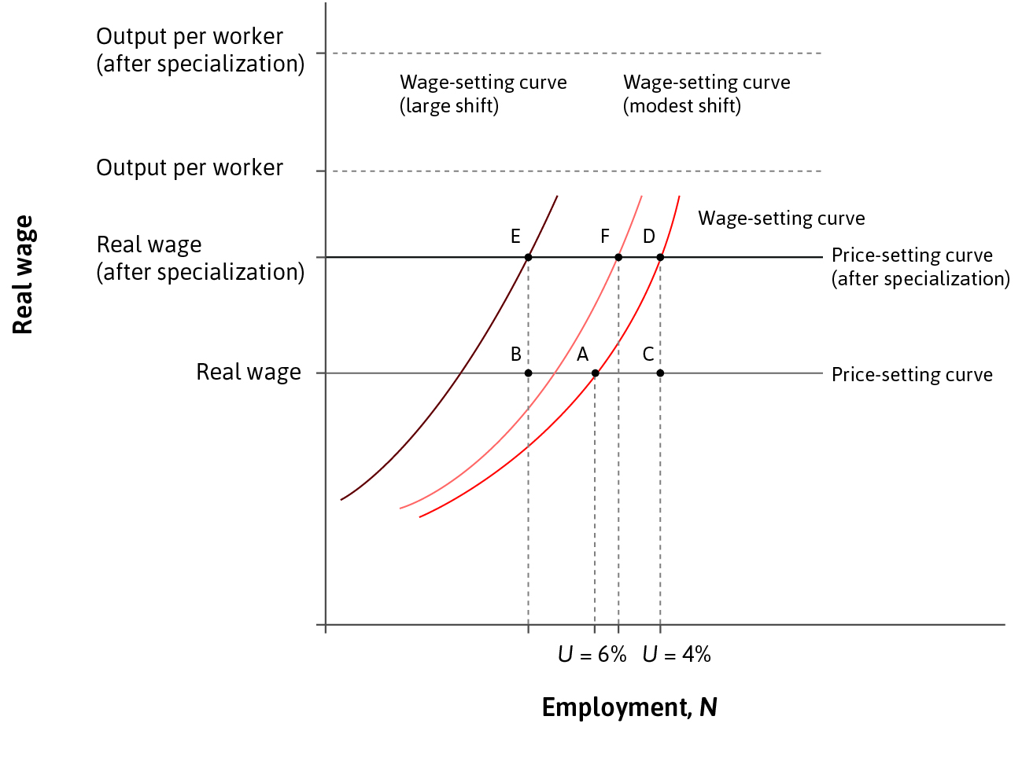
Winners and Losers: Long Run
Specialization according to comparative advantage has similar labour market effects as technological progress.
Increased productivity shifts the price-setting curve upwards:
In the short run, jobs are destroyed.
In the medium run, growth in export industries creates new jobs.
Long-run adjustment process depends on how much wage-setting curve shifts.

Slide 21
D. The role of policies and institutions

Slide 22
The power of governments
Governments have additional powers over their national boundaries (compared to within their nation):
Imposition of tariffs: Taxes on imports effectively discriminate against foreign-produced goods.
Immigration policies: Regulate the movement of people between nations that is not possible within nations.
Capital controls: Limits on the ability of individuals or firms to transfer financial assets among countries.
Monetary policies: Affect the exchange rate hence the relative price of imported and exported goods.

Slide 23
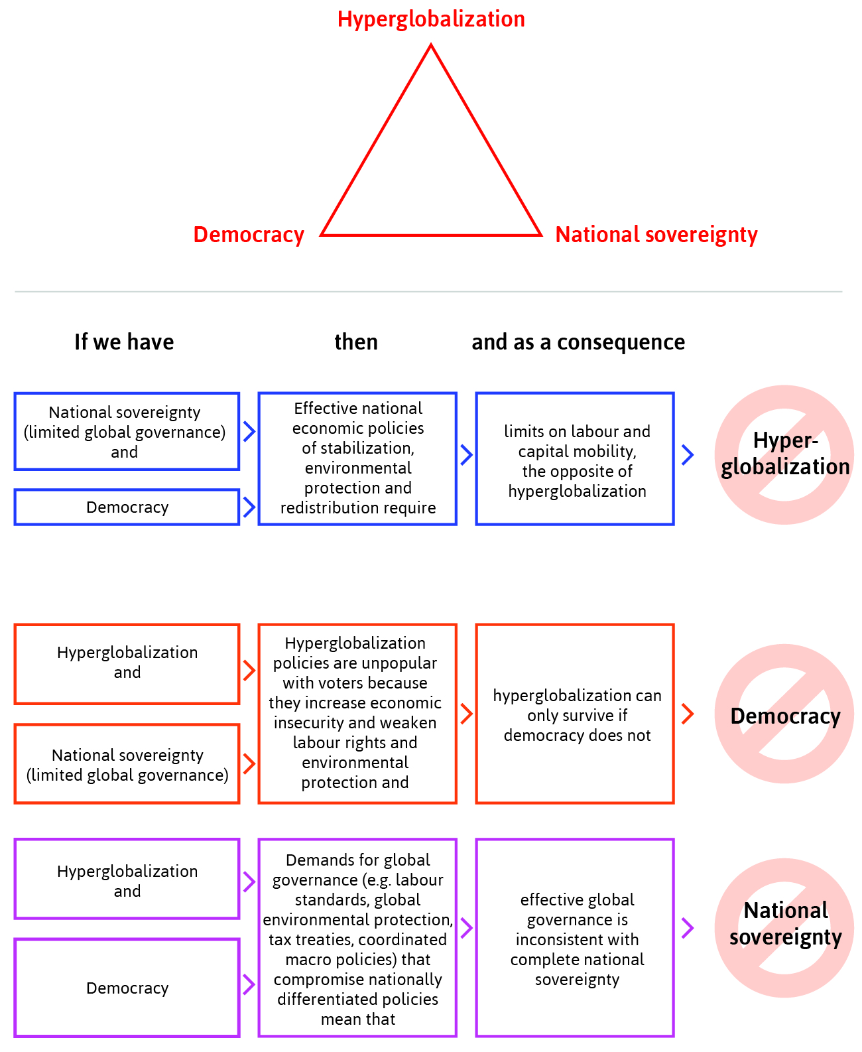
Rodrik’s Trilemma
One argument against globalization is that nations must give up some sovereignty or democracy.
Rodrik’s Trilemma states it is impossible for countries to simultaneously achieve:
Hyper-globalization - no political or cultural barriers to the flow of goods and investment
Sovereignty – pursue the policies that it chooses
Democracy – liberty and equality

Slide 24
Rodrik’s Trilemma: Summary

Slide 25
Trade and Growth
Globalization can promote growth:
Competition with foreign firms accelerates the rate of technological progress
Economies of scale due to foreign demand allows for lower-cost production, which benefits workers, owners, and buyers
Globalization can also prevent growth:
Disadvantageous specialization – specializing in low-innovation sectors can slow growth
Learning by doing in infant industries – may need temporary tariff protection

Slide 26
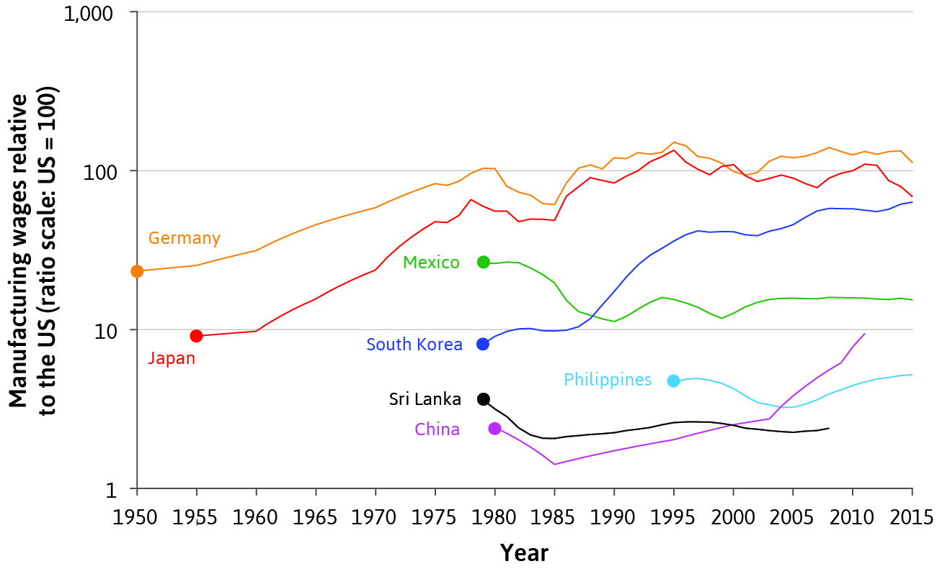
Globalization and economic performance
Some countries have benefitted more from globalization than others. Economic success depends on how well policies have managed growth due to economic integration.
During industrialization, Germany and the US achieved high economic growth despite high manufacturing tariffs.
Scandinavian countries prospered through openness, with policies that help displaced workers.

Slide 27
Summary
Economies have become more integrated over time
Specialization and trade can be mutually beneficial
Winners and losers in the short run, both within and between countries, depending on relative factor abundance
All parties can benefit in the long-run with good policymaking
2. Globalization brings new policy challenges
Rodrik’s Trilemma shows policymaker’s tradeoffs
Long-run success depends on policies that promote growth

